Slide 1
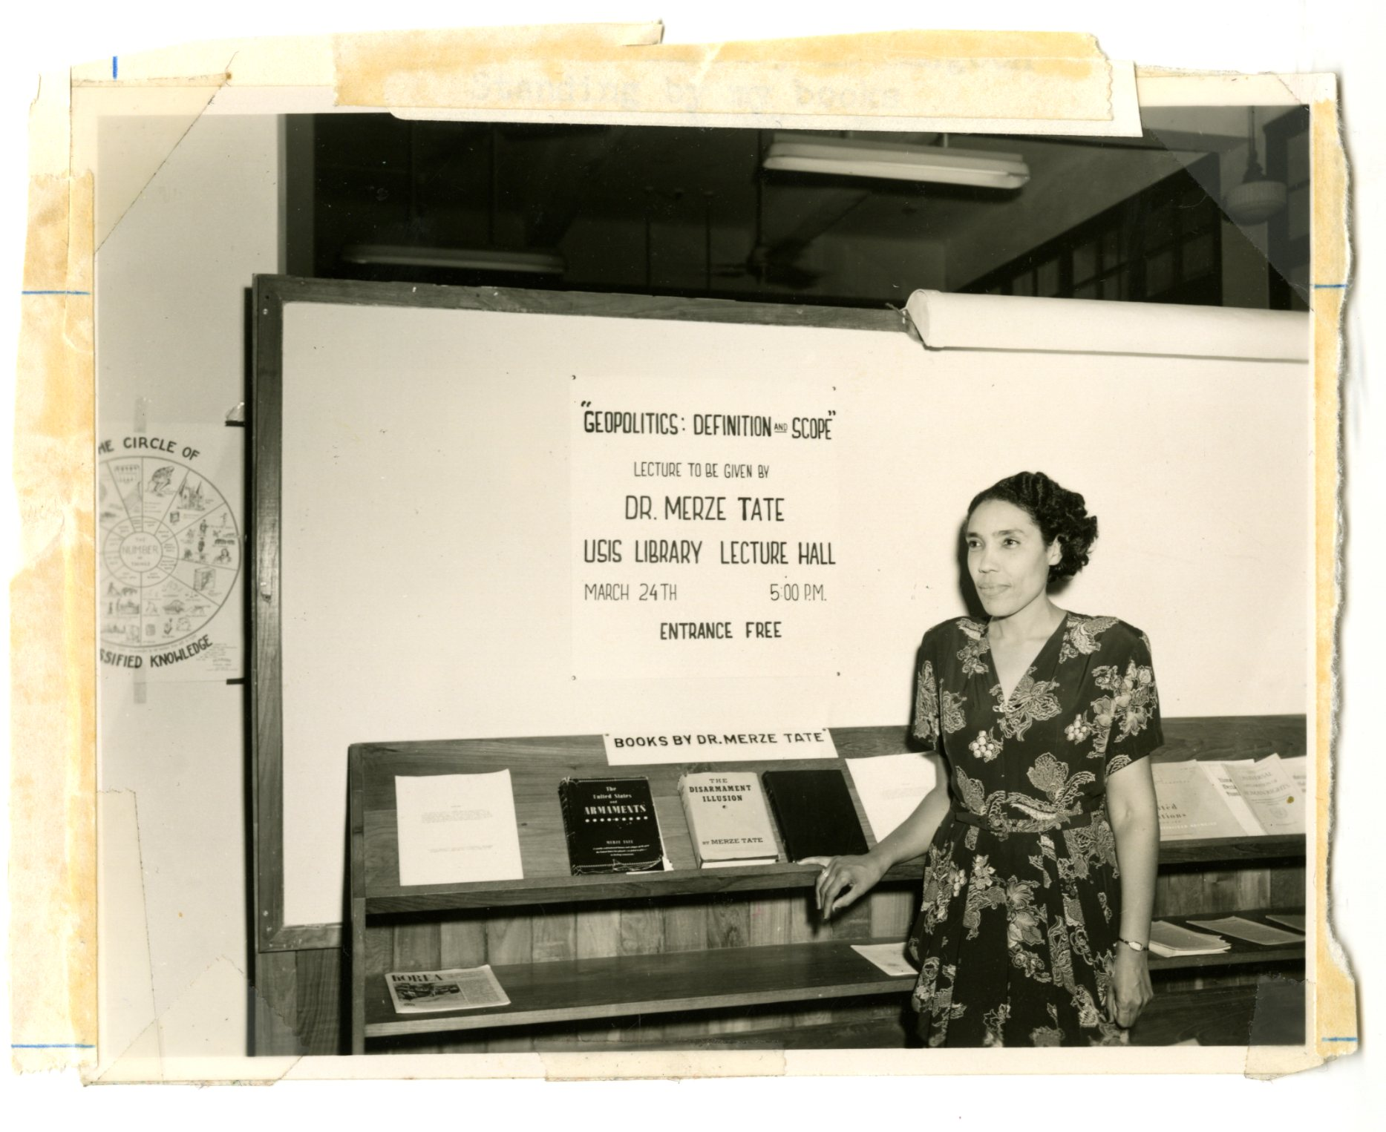
Pioneering the Social Sciences at the Periphery: Howard University 1930-1950
The Geopolitics of Place and Race
Krista Johnson, Howard University

Slide 2
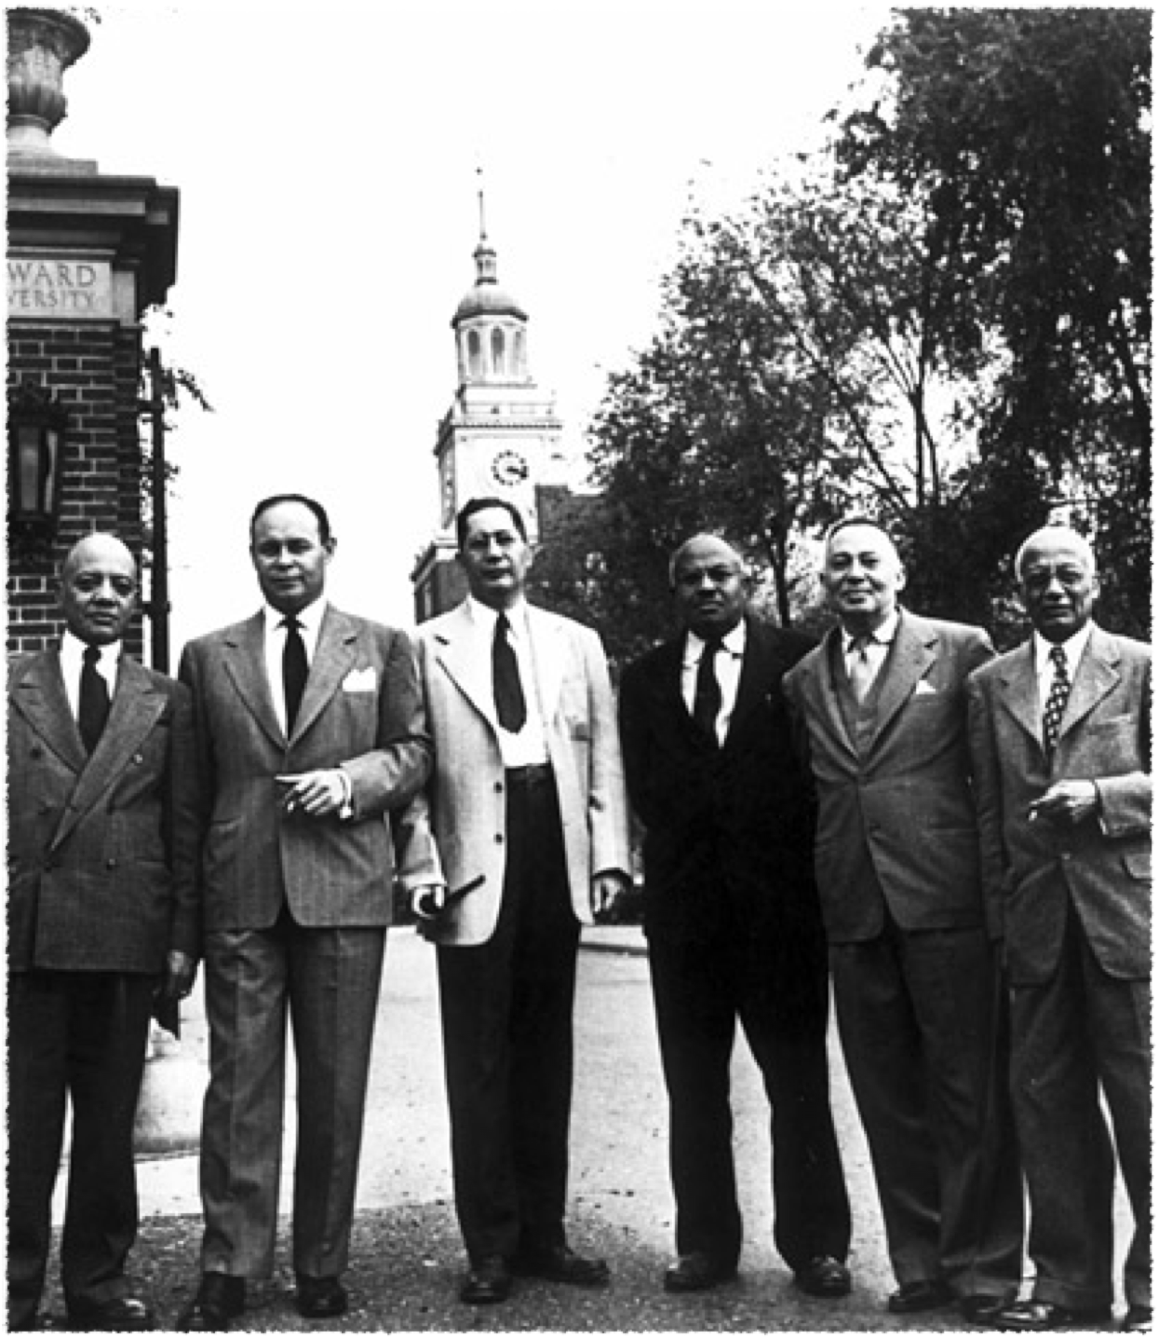

The Howard School
engaged in transformative scholarship and intellectual theorising on race and empire in the United States and around the world.
broke away both from the mainstream American disciplinary approaches of the time and from the institutional limitations of black universities.
built a vibrant intellectual community, an animated inter-war Black Atlantic world that included figures like W.E.B. DuBois, George Padmore and C.L.R. James, among others.
foregrounds the black experience in the US and the world more generally.

Slide 3
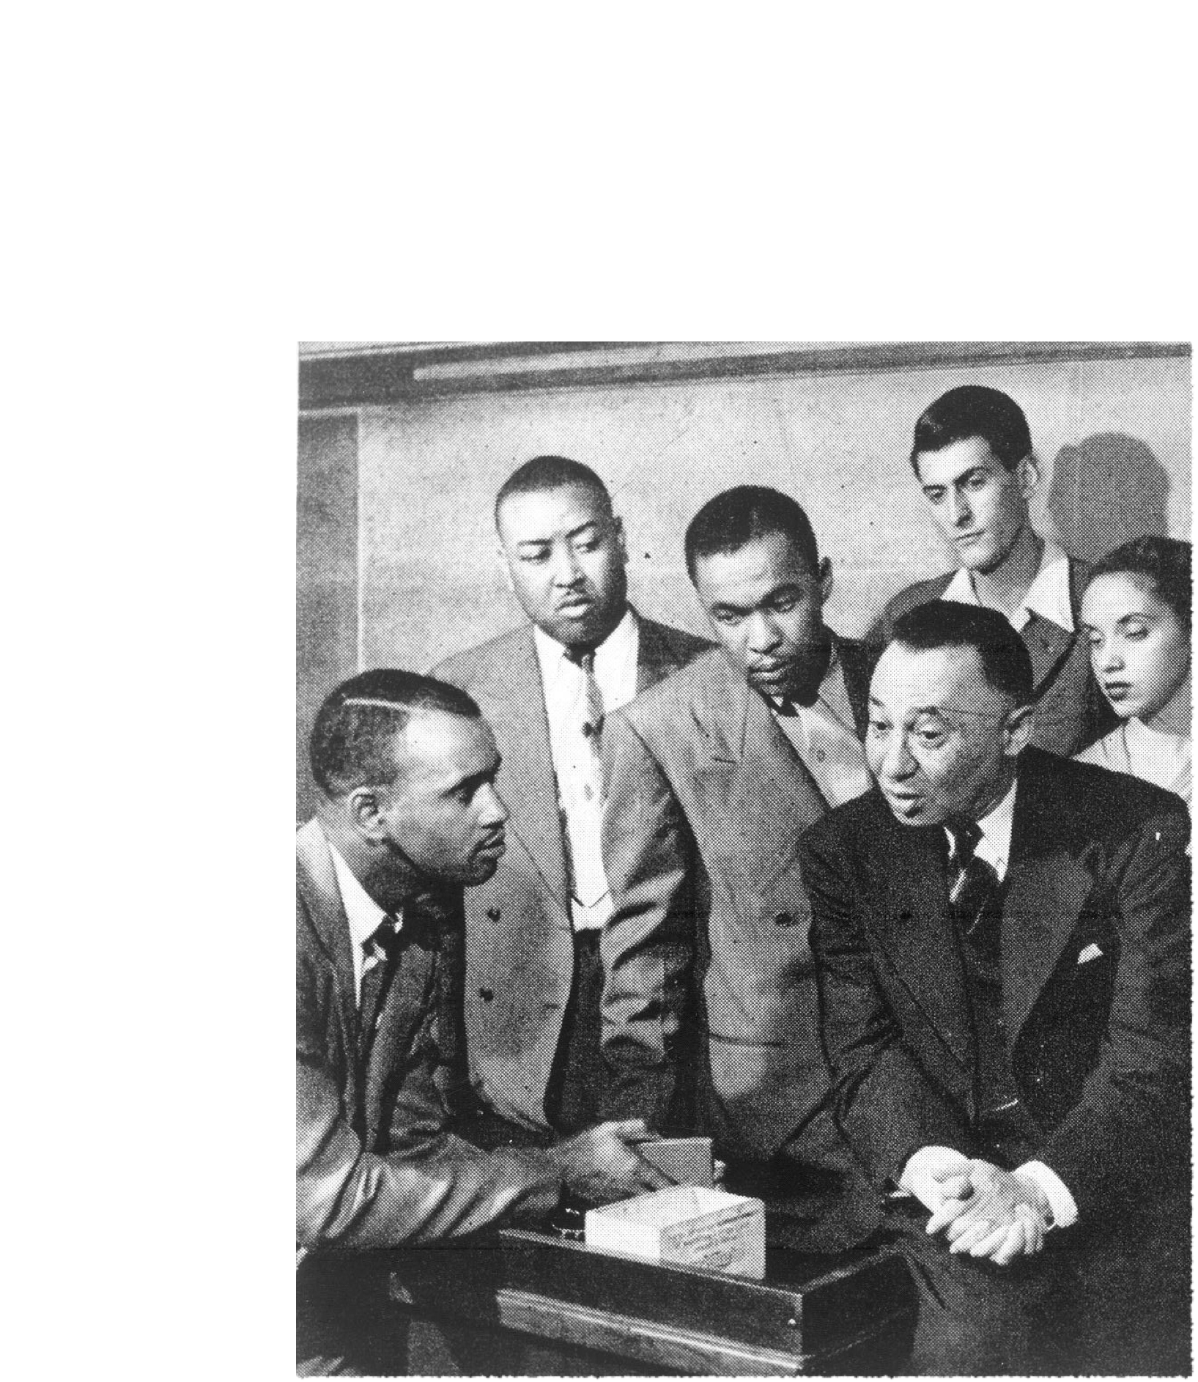
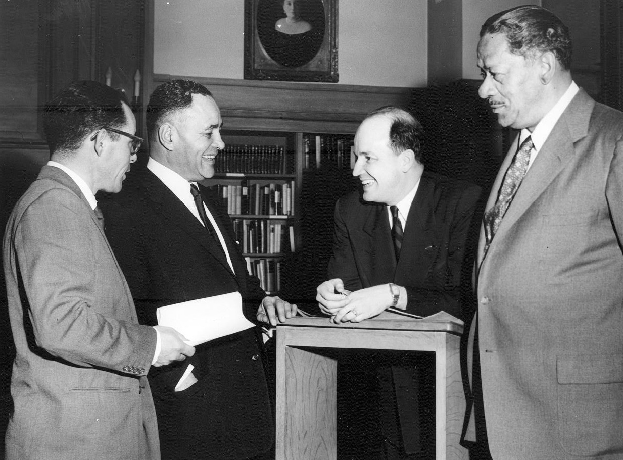
The Howard School
Alain L. Locke
Sterling A. Brown
Rayford Logan
Charles Wesley
Merze Tate
Charles Thompson
William Leo Hansberry
Abram Harris
E. Franklin Frazier
Eric Williams
Ralph Bunche

Slide 4
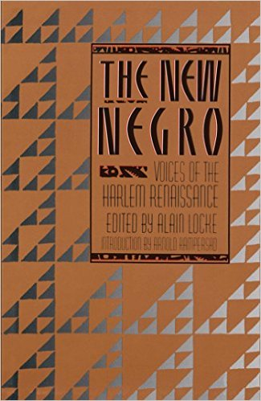
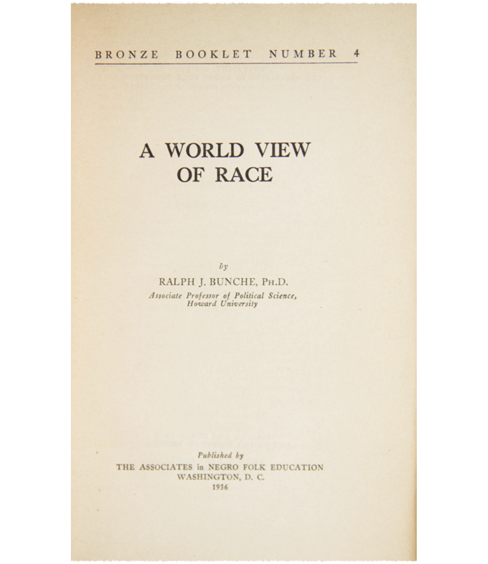
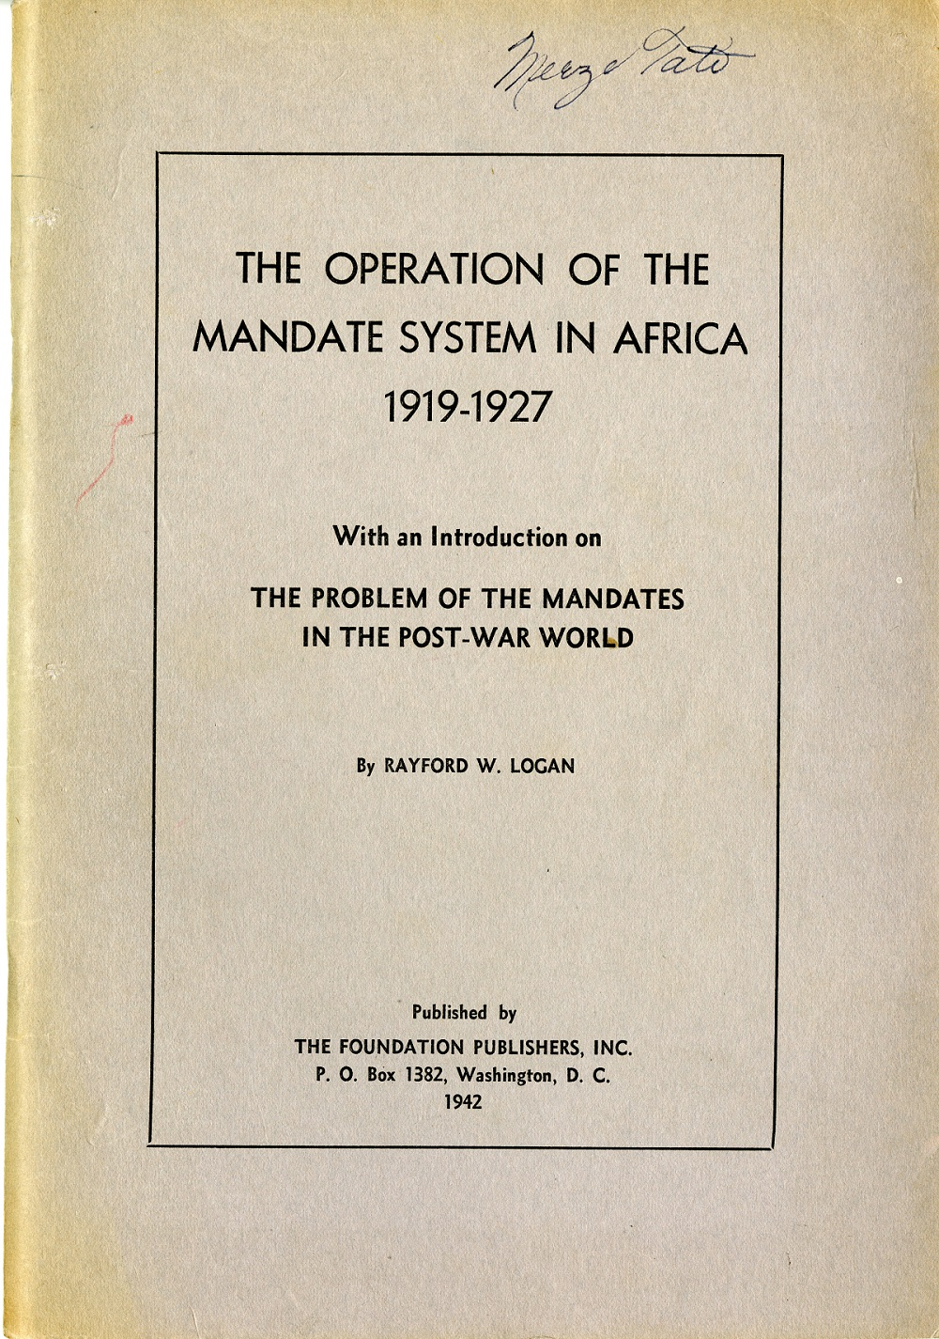
Novel Theories and Paradigms
a model of decoloniality that incorporates the strategies of 1. Problematizing hegemonic paradigms, theories and schools of thought; 2. Demythologizing history, and 3. Decolonizing knowledge production.
Ralph Bunche’s theorization of hierarchy as the modus operandi of international relations, rejecting dominant approaches that privilege anarchy or power politics as the primary ordering principal in the international system.
a “diasporist” paradigm of international relations.

Slide 5
Institutional Architecture
Journal of Negro Education
the Annual Conferences of the Social Sciences Division

Slide 6

The Capstone of Negro Education
Howard was founded in 1867
History of Howard and HBCUs tied to racial attitudes of the broader society
Howard’s administration was unwilling, and hostile, towards supporting a robust program of research and scholarship.
Another factor working against black scholars was the fact they lacked funding, and often cooperation from benefactors and white scholars at the large universities.
white gatekeepers steered foundation funding towards themselves and the establishment of research centers at white universities

Slide 7
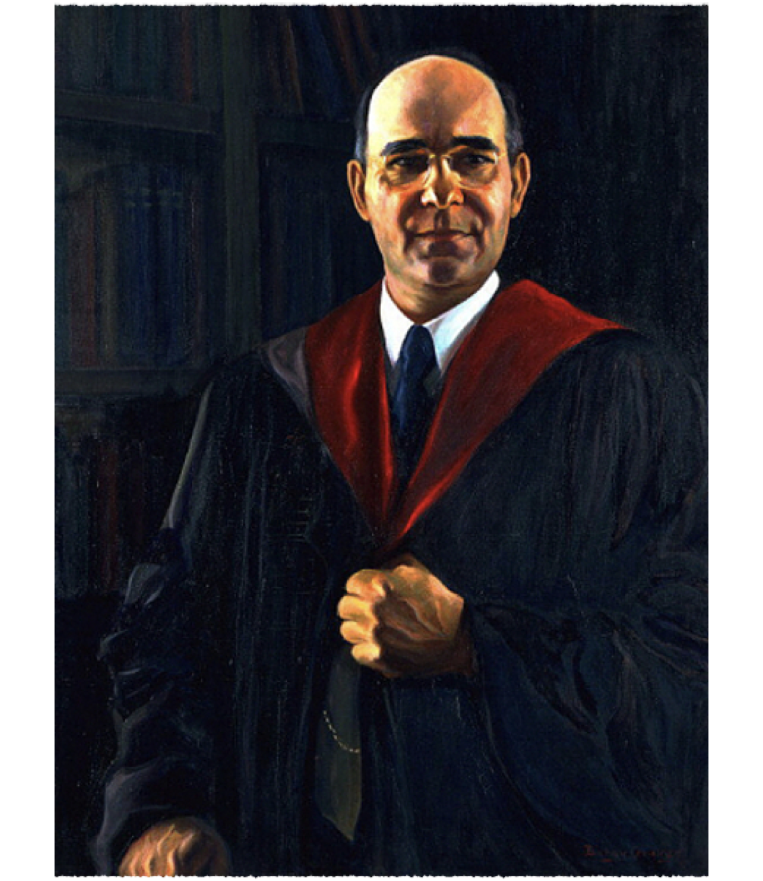
The GoldenAge of Scholarship
The period of 1926 to the 1950s has been described as “the golden age” of black scholarship, particularly at Howard.
University’s first black president appointed in 1926, Mordecai W. Johnson
unique, Afro-diasporan cosmopolitan environment with deep and rich ties to subaltern activists and nationalists in Africa, the diaspora and non-European territories including India and China.
engagement with African and Afro-Diasporan students and intellectuals.

Slide 8
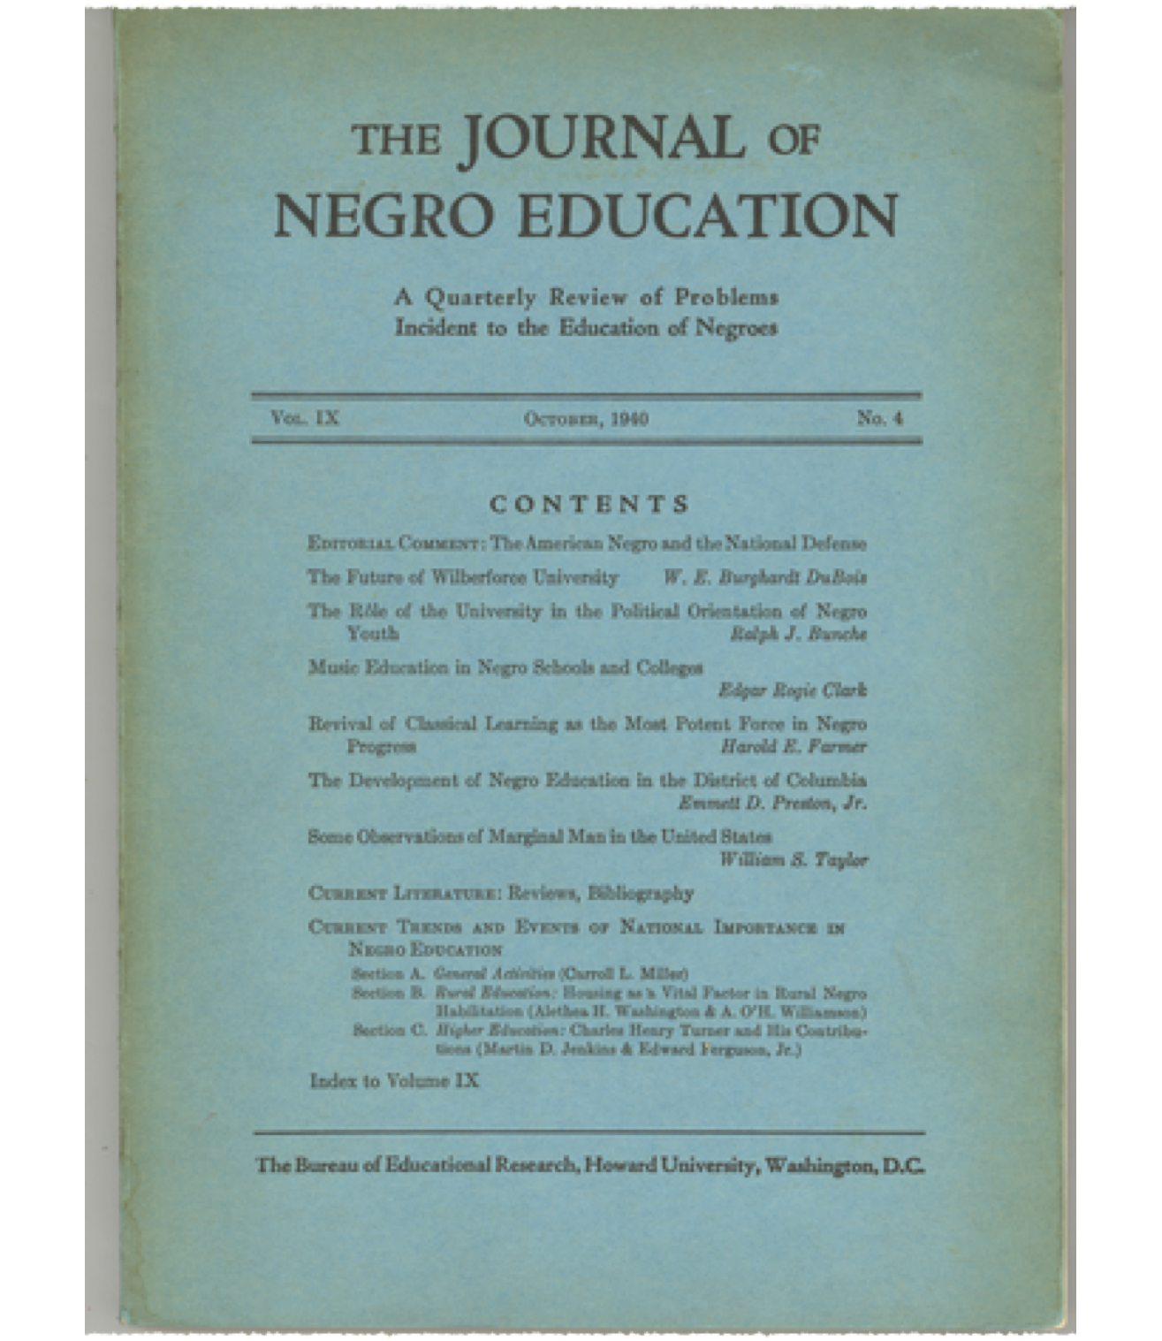
Journal of Negro Education
An important catalyst for the convergence and dissemination of such black cosmopolitan thinking was the Journal of Negro Education, which was founded by Charles H. Thompson in 1932.
And from the outset, Thompson defined education broadly.
A key component of the Journal were the editorials by Thompson in which he sought to cultivate black cosmopolitan thinking, and encouraged blacks to adopt a global orientation to racial oppression.
Another key feature of the Journal was the annual Yearbook

Slide 9
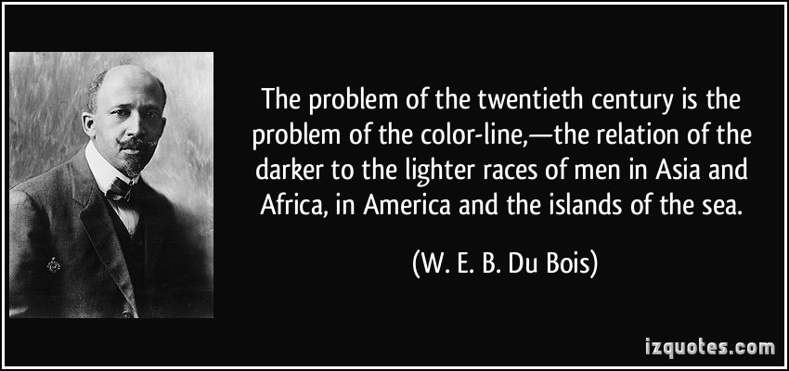
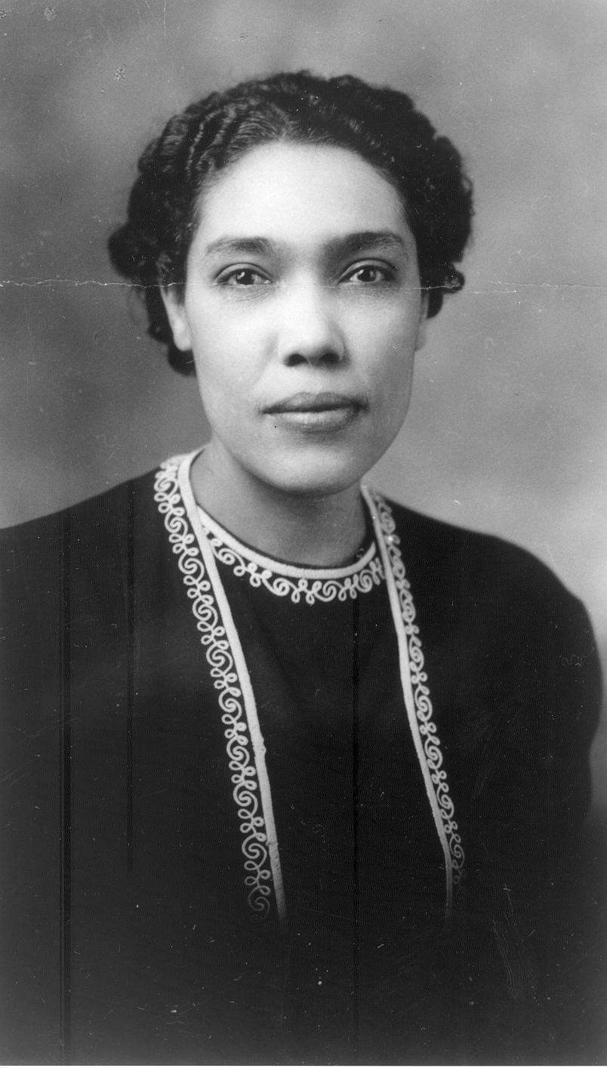
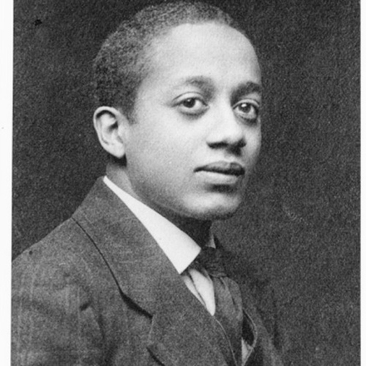
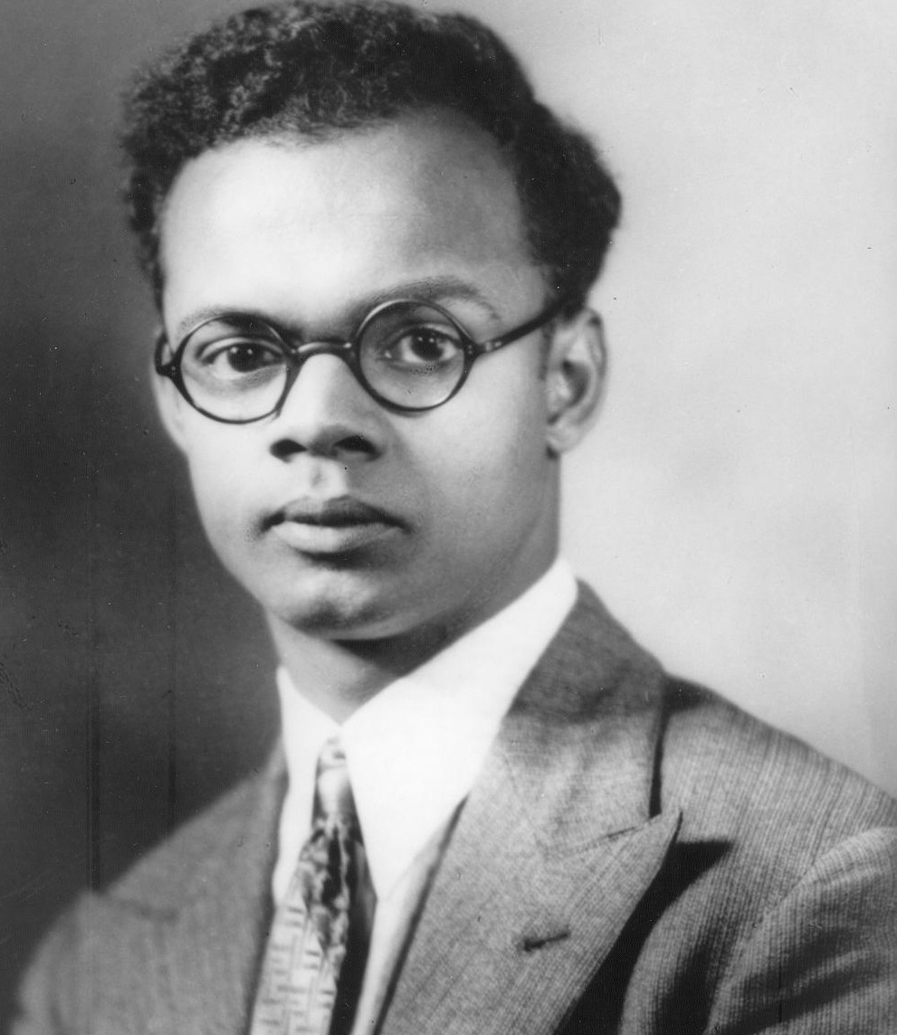
Conferences of the Division of the Social Sciences
viewed the conferences as an extension of the patterns of instruction in the Division, and placed great emphasis on objectivity, expertness, theoretical grounding, and application to practical issues and problems.
the first conference on “Problems, programs and Philosophies of Minority Groups” held in 1935
The analytical and methodological framework they had in mind for such a research program was decidedly world-oriented, and relational.

Slide 10
Conclusions
The work of the Howard scholars reflect many of same contradictory impulses that persist today
Tension between reform and revolution
Repurposing of university resources
Building institutional model based in the academy but tethered to the community

