Slide 1
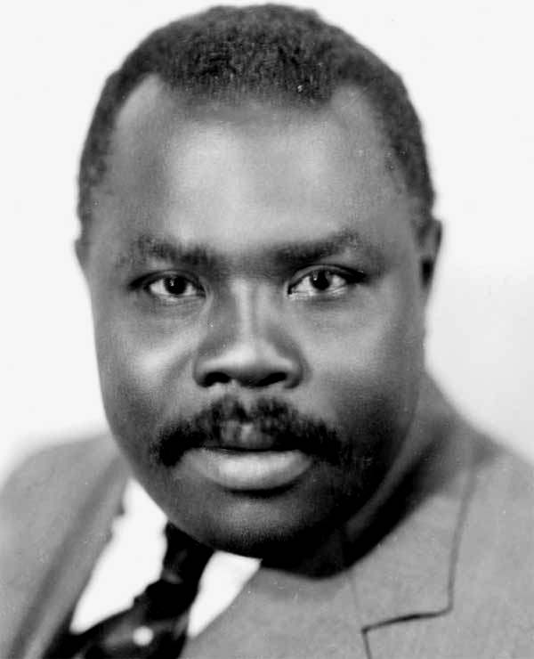
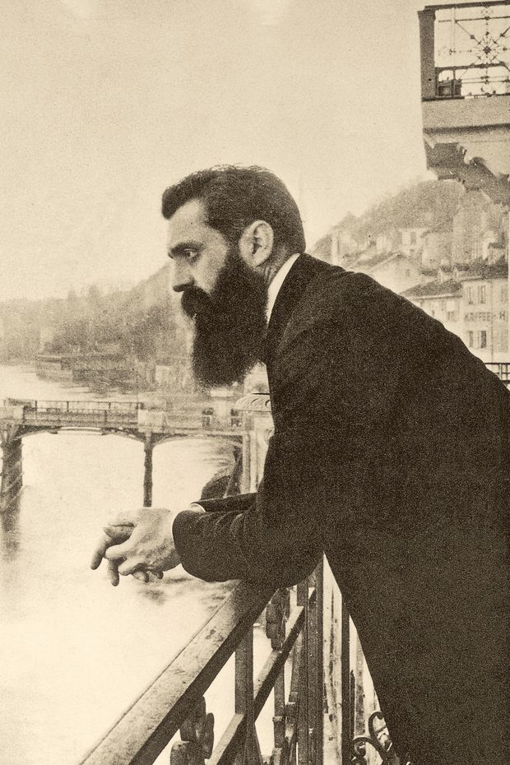
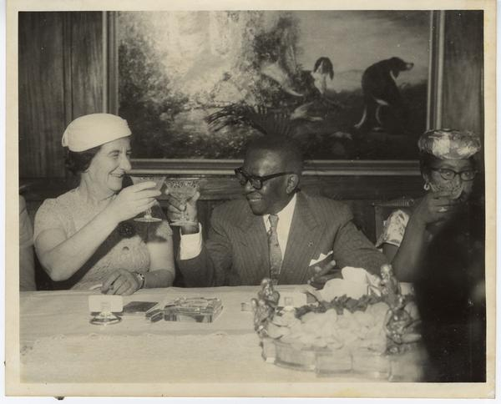
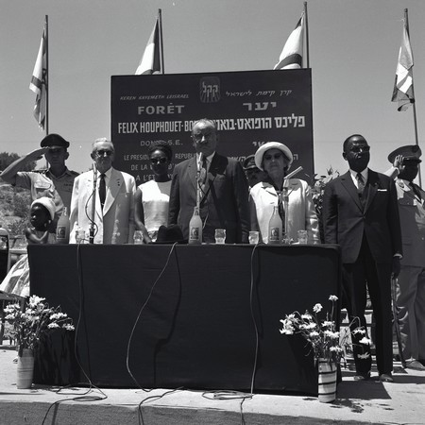
Contribution and Cooperation- Jewish and African Diasporas and the national liberation project before independence
By Benji Shulman

Slide 2
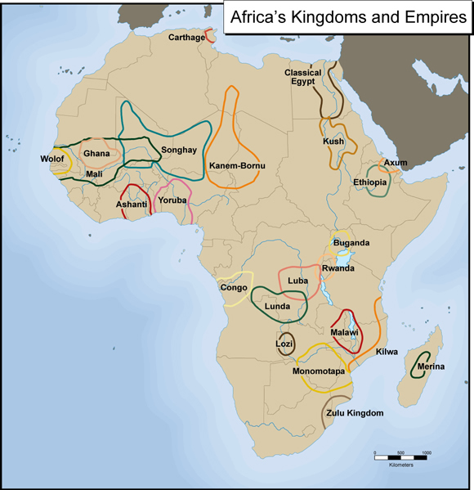
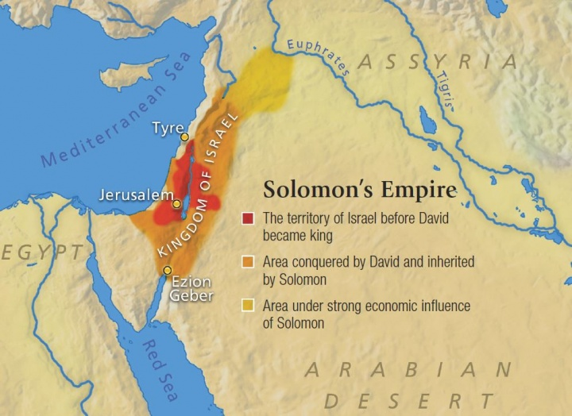
Introduction – States and Diasporas

Slide 3
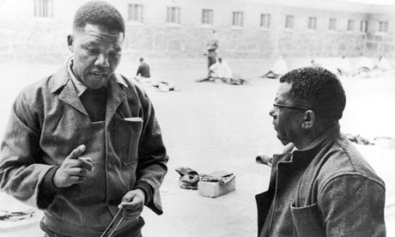
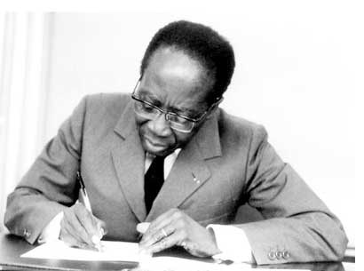
State Relations in 1950s and 1960s
Israel established by UN vote in 1948 for African states start gaining independence in the 1950s starting with Ghana
Kicks off period of intense diplomatic activity
Israeli establishes relations with 32 African countries,
Biggest embassy presence in Africa except for former European colonies.
A dozen new embassies in Israel, most in Jerusalem
By 1965, most major Africa leaders had visited the country.
Israel’s friends include Emperor Haile Selassie of Ethiopia, President Leopald Senghor of Senegal, Jomo Kenyata of Kenya and President of Liberia, William Tubman. Also informal ties with the ANC – Nelson Mandela mentor Walter Sisulu

Slide 4
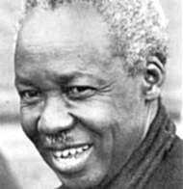
Not just on paper
“Israel is a small country… but it can offer a lot to a country like mine. We can learn a great deal because the problems of Tanganika are similar to Israel’s.” - Tanzanian president, Juluis Nyerere, 1957

Slide 5
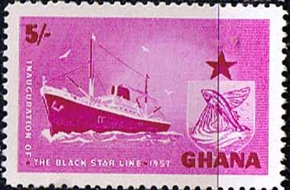
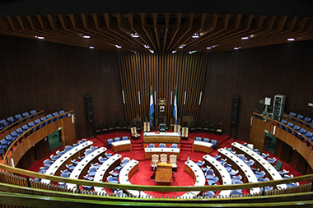
Practical Aspects
Many joint projects in a number of areas including:
Sectors included: Construction, Agriculture, Aquaculture, Health Care, Hydrology, Youth Movements, Regional Planning, Engineering, Community Services
Examples – Building the Sierra Leone parliament, Creating the Black Star Line Shipping company, Ghana, Specialist eye clinic, social work training in Kenya
Scholar exchange - Hebrew University and the Mount Carmel Centre for women in the developing world.
Safety and Security: Military and police. The first pilots of the Kenyan and Tanzanian Air Forces; Ghana’s first naval academy.

Slide 6
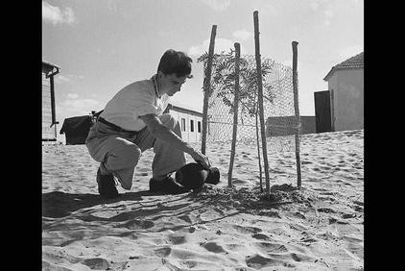
“ Israel has given me more in eight days than I could obtain from a British university in two years”. John Tettegah, Secretary General of Ghana’s Trade Union movement, 1957

Slide 7
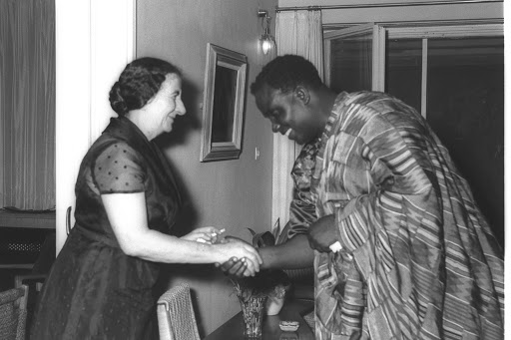
Why – The Geopolitical View
Cold War – East vs West
Diplomatic Isolation – multilateral institutions
Demands of state building – development challenges
A safe partnership – worries about neo-colonialism
But this view limited:
A historical – Assumes relationship begins from a “standing start”
Useful now? – Less state involvement, geo politics have changed
Other forces – religion, socialist leadership? Can we use Diaspora lens?

Slide 8
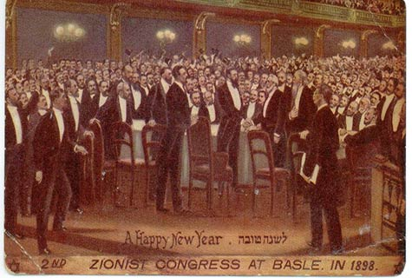
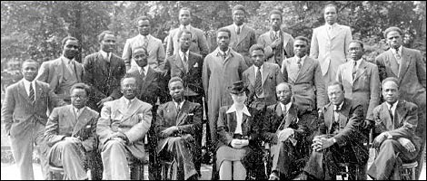
Diaspora Lens
Early 19th century
Significant African and Jewish diasporas around the world
Serious challenges faced by both groups: Antisemitism, Racism, Colonialism
One idea that is seen a solution to the problem is national self determination – independent nation states.
The first Zionist Congress for the creation of Jewish state is in 1897, followed one month later by calls for an African Association.
Both events happen in the Diaspora
Early on each sees potential in collaboration
Sets the stage for post independence

Slide 9
Intellectual Engagements – Theodore Herzl, founder of the Zionist Movement
Altneuland (1902) – “There is still one other question arising out of the disaster of the nations that only a Jew can comprehend. This is the African question. Just call to mind all those terrible episodes of the slave trade, of human beings who, merely because they were black, were stolen like cattle, taken prisoner, captured and sold. Their children grew up in strange lands, the object of contempt and hostility because their complexions were different . I am not ashamed to say, though I expose myself to ridicule in saying so, that once I have witnessed the redemption of the Jews, my people, I wish to also to assist in the redemption of the Africans”

Slide 10
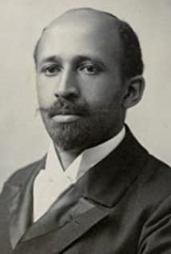
Pan–African thinkers - W.E.B du Bois
W.E.B du Bois -“The Africa movement means the same to us as what the Zionist movement must mean to Jews.”
W.E.B du Bois -“Young and forward thinking Jews, bringing a new civilisation into an old land and building up that land out of the ignorance, disease and poverty into which it had fallen and by democratic methods to build a new and peculiarly fateful modern state.”

Slide 11
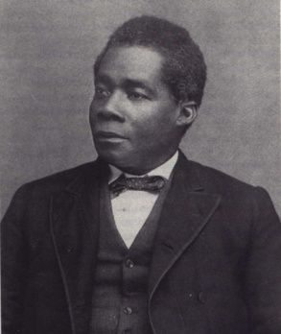
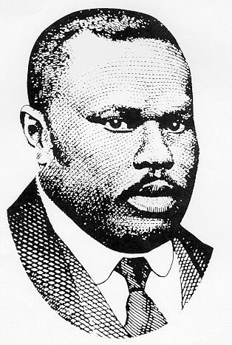
Pan African thinkers continued…
Marcus Garvey - “Many white men have tried to uplift them, but the only way is for the Negros to have a nation of their own, like the Jews, that will command the respect of the nations of the world with it achievements”
Edward Wilmot Blyden “that wonderful movement called Zionism”
Others, Writings Robert R Delaney, works of Paul Robeson

Slide 12
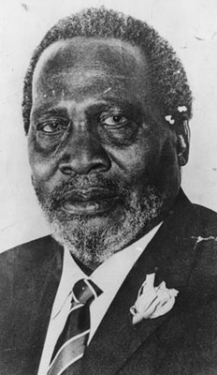
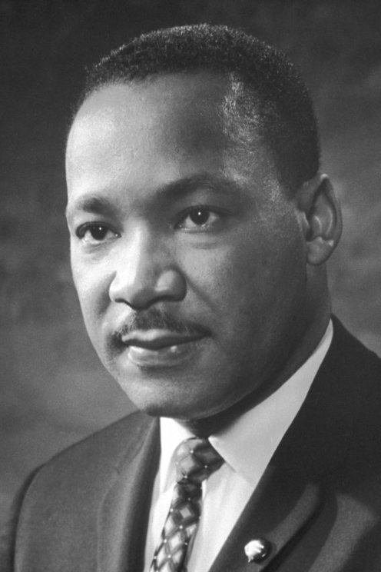
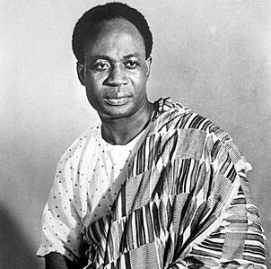
What are the effects… Civil Rights, African Liberation Movements
“When people criticize Zionists, they mean Jews. You’re talking anti-Semitism” – Martin Luther King Jr
You have built a nation with Jews coming from all corners of the world; we want to build a unified Kenya of a multitude of tribes joined together through Harambee (working together). - President Jomo Kenyatta, Kenya
“ We Jews and Negroes understand one another, we have both suffered and now we both have our own independent states” Kwame Nkrumah, President Ghana

Slide 13
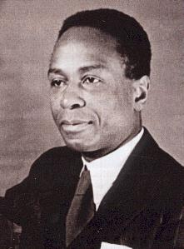
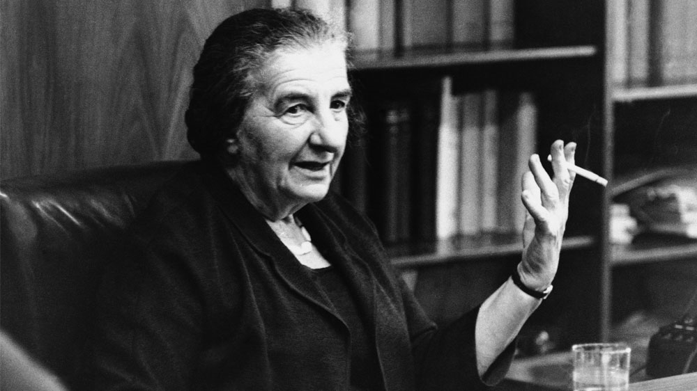
Activism, mutual support, comparing notes…
Pan-Africanist George Padmore - Believed that Africa’s development could supported by funding from the African-American Diaspora, along the same lines as the Zionist campaign known as the United Israel Appeal.
Introduces Israeli cabinet minister Golda Meir and later Prime minster to the 60 delegates of the All Africa Peoples of Conference in Ghana 1958.
Important advisor to Kwame Nkrumah

Slide 14
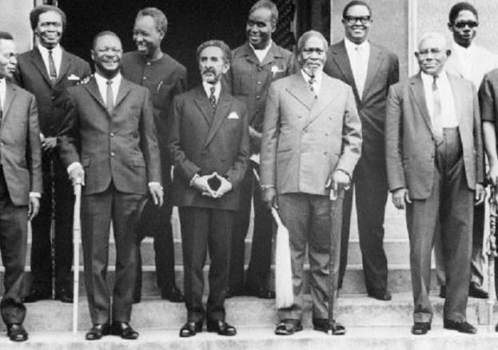
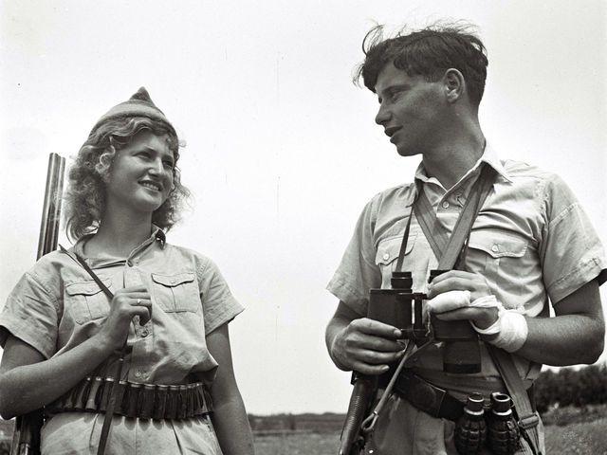
Safety and Security
One of the organisers at the fifth pan-Africanist Congress in Manchester in 1945, Rus Makonnen from Guyana:
“Undoubtedly what was going on in Palestine with the Jews was an important experience for us as members of this other diaspora… so the Jewish experience was formidable. We felt the particularity of the Africans, our Africaness, just like Jewishness. And later we wondered when we saw a handful of Jews in the Haganah movement gaining independence militarily for Palestine, whether we could do the same.”
Haganah - Early unit in what would become the Israel Defence Forces

Slide 15
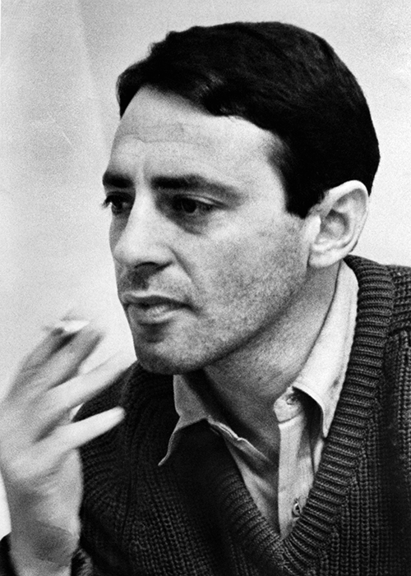
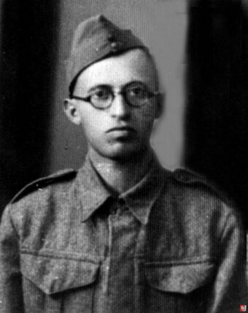
South African Example -
Inspiration for the structure of the ANC’s Umkhonto we Sizwe (MK) armed forces:
Nelson Mandela, Rivonia Trial speech -“We discussed ideological and practical questions, the Congress Alliance, Umkhonto and its activities generally, and his experiences as a soldier in the Palmach, the military wing of the Haganah. Haganah was the political authority of the Jewish National Movement in Palestine.”
Nelson Mandela, Rivonia Trial speech – “Incidentally, the terms High Command and Regional Command were an importation from the Jewish national underground organization Irgun Zvai Leumi, which operated in Israel between 1944 and 1948”
“I read “The Revolt” by Menachem Begin and was encouraged by the fact that the Israeli leader had led a guerrilla force in a country with neither mountains nor forests, a situation similar to our own”.- Long Walk to Freedom

Slide 16
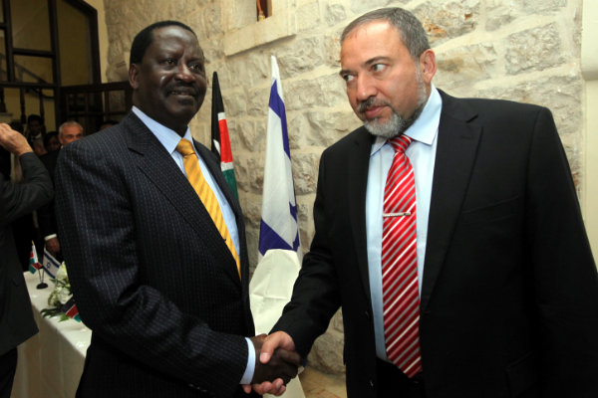
Conclusion
Important interaction between Israel and Africa 1950s and 1960s
Geo-political understanding is important but is also limited
Diaspora concept shows that interactions go back at least a century and were important paving blocks for those relationships.
Interactions were around the politics of the liberation movement
Interactions marked at both intellectual level and activism level
Helps better understand relations back then and how they might go forward today.
Questions: Egoligreen@gmail.com

