Slide 1
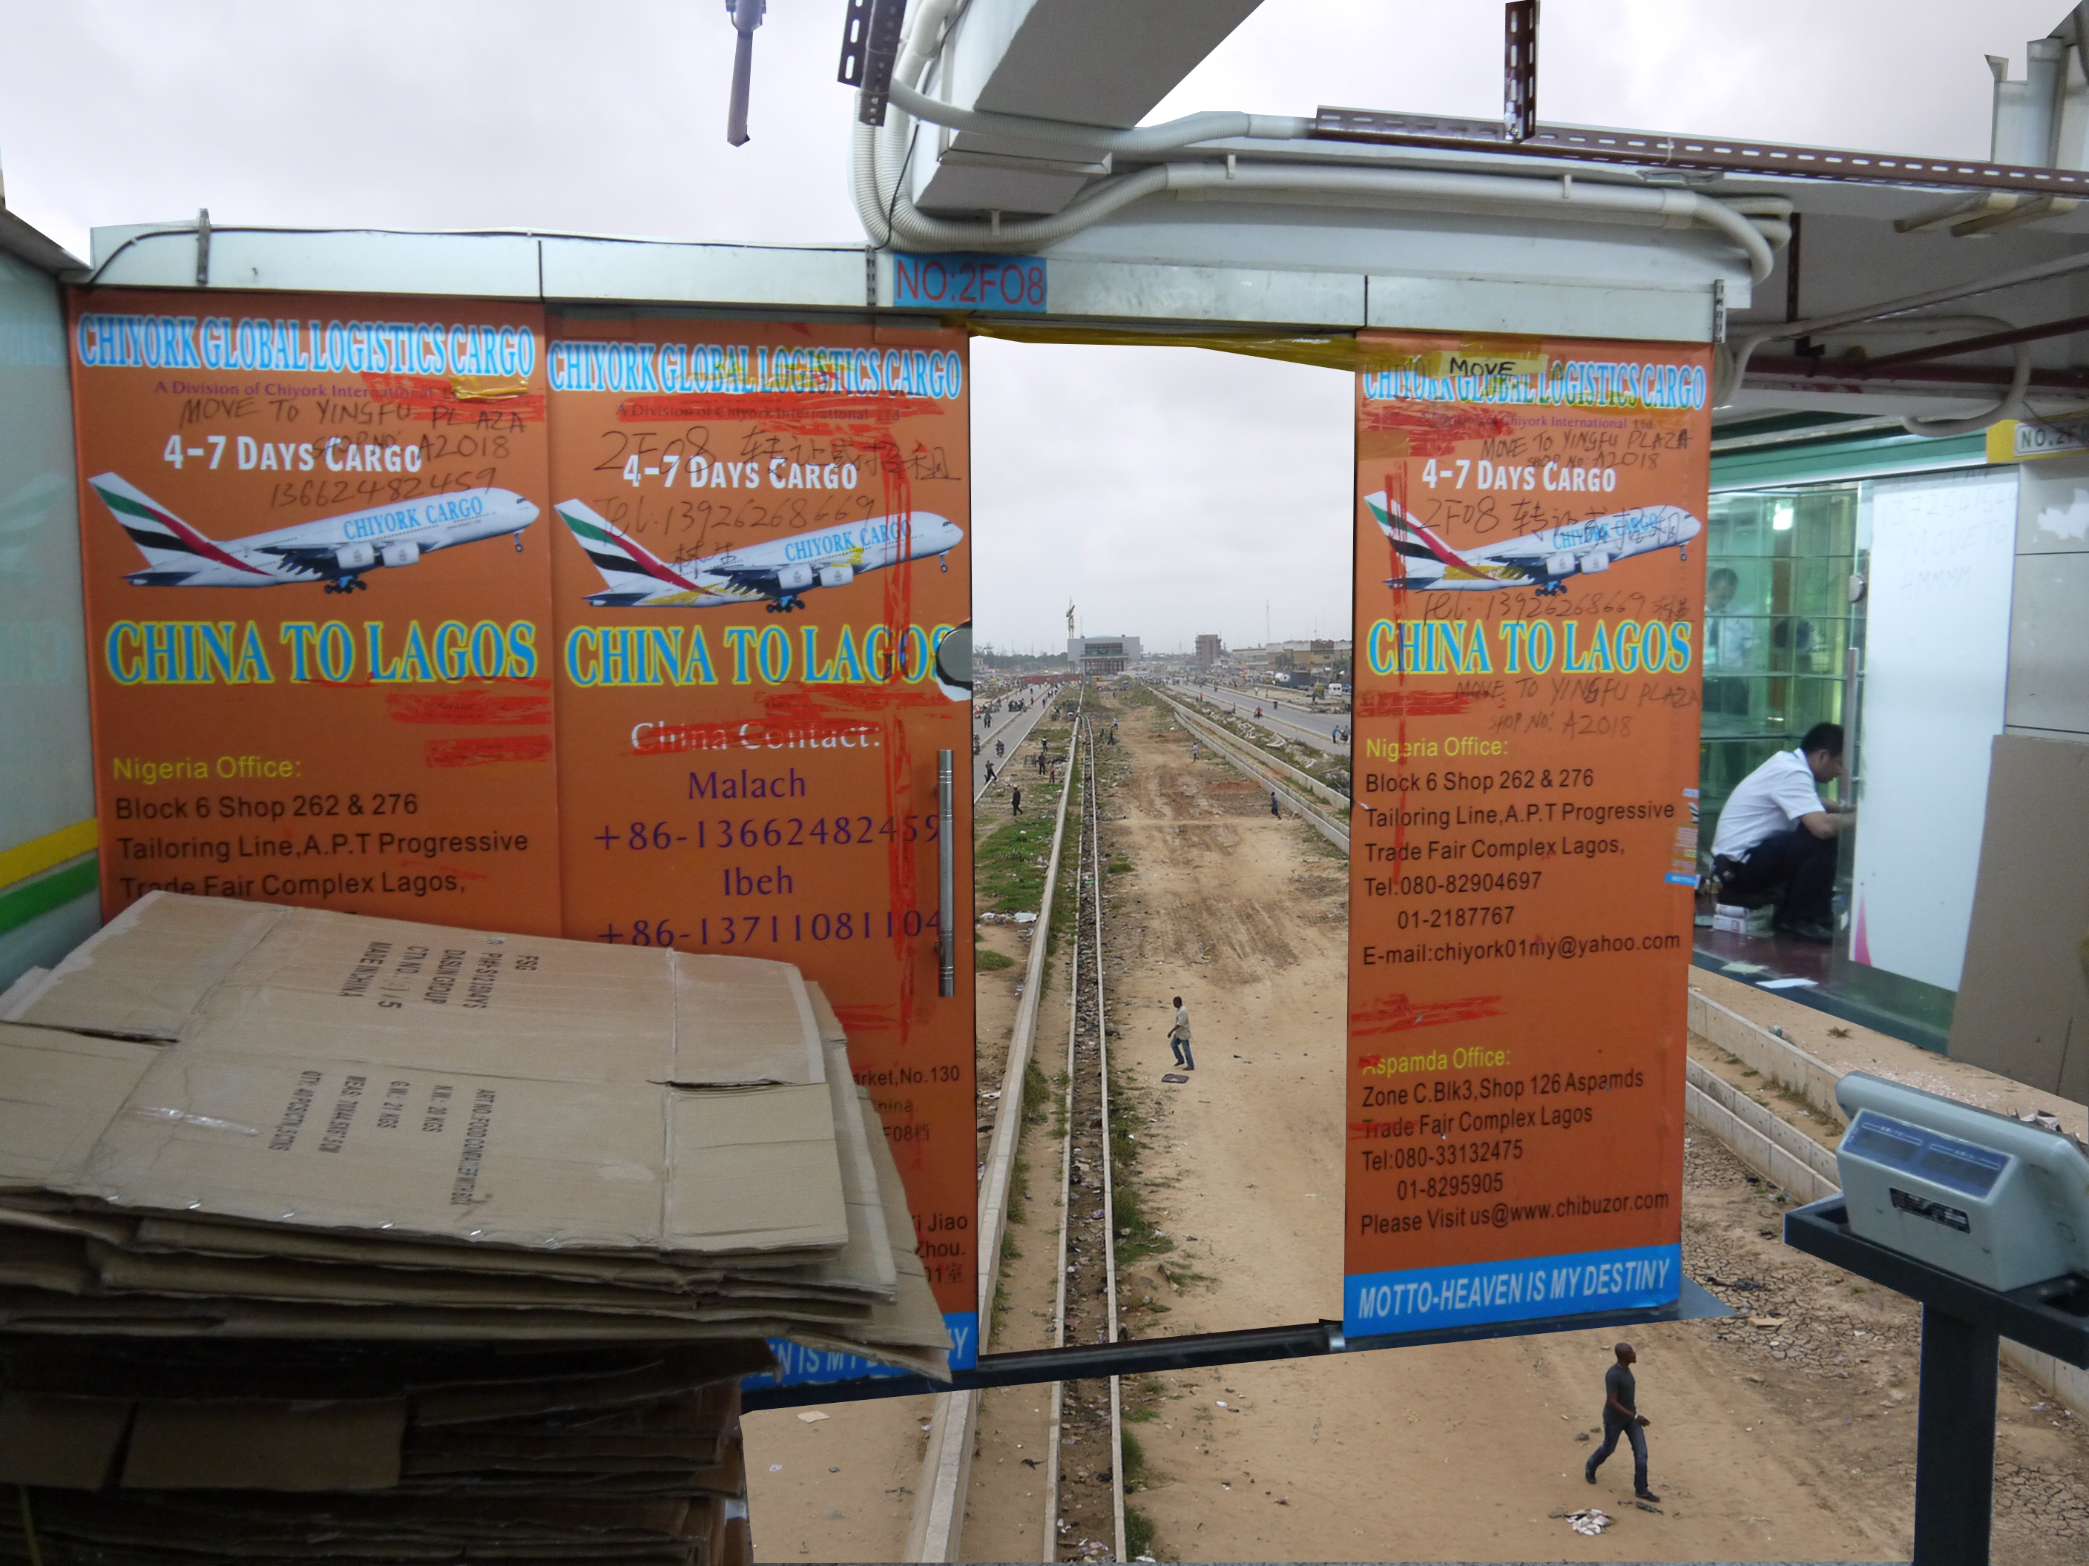
Race and notoriety
in diasporic Nigerian life
Vivian Chenxue Lu
Fordham University
vlu2@Fordham.edu

Slide 2
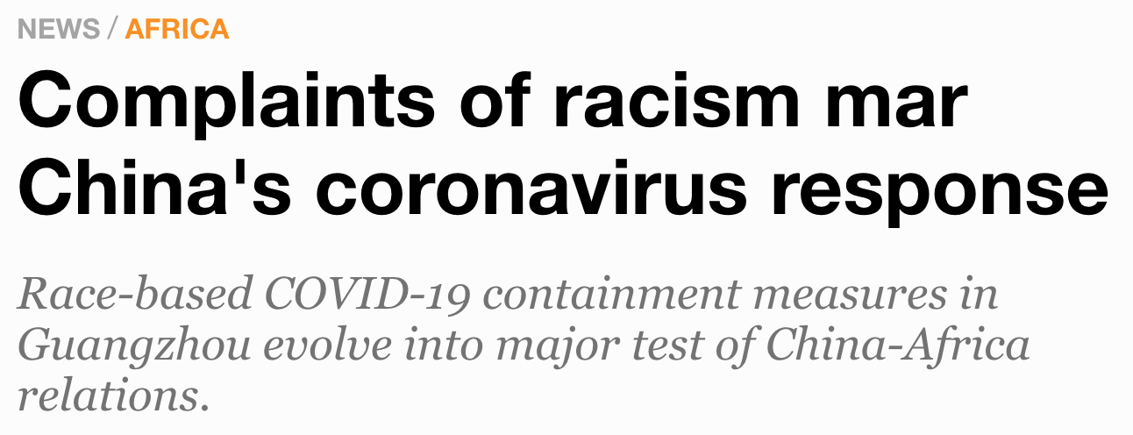
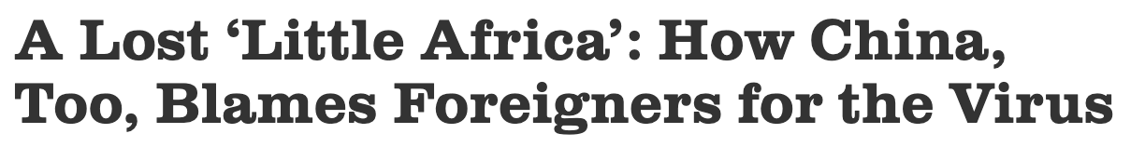
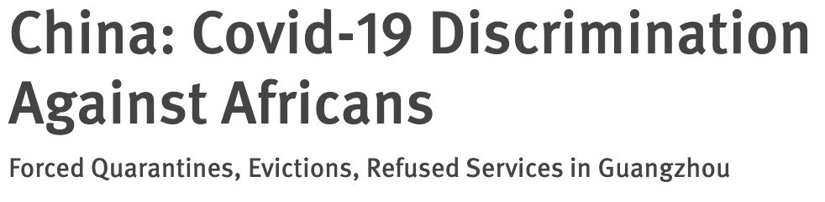
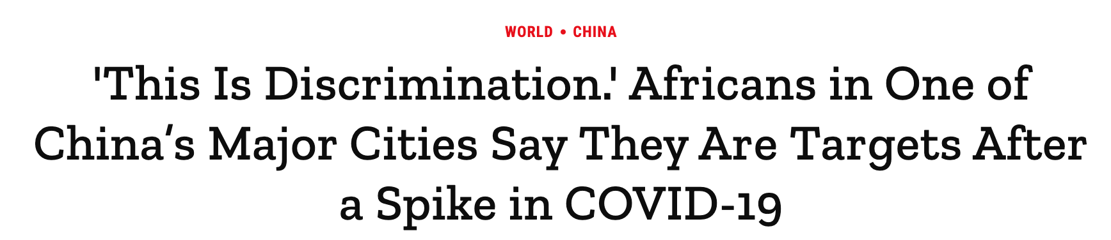
April 2020 Covid-19 Headlines

Slide 3
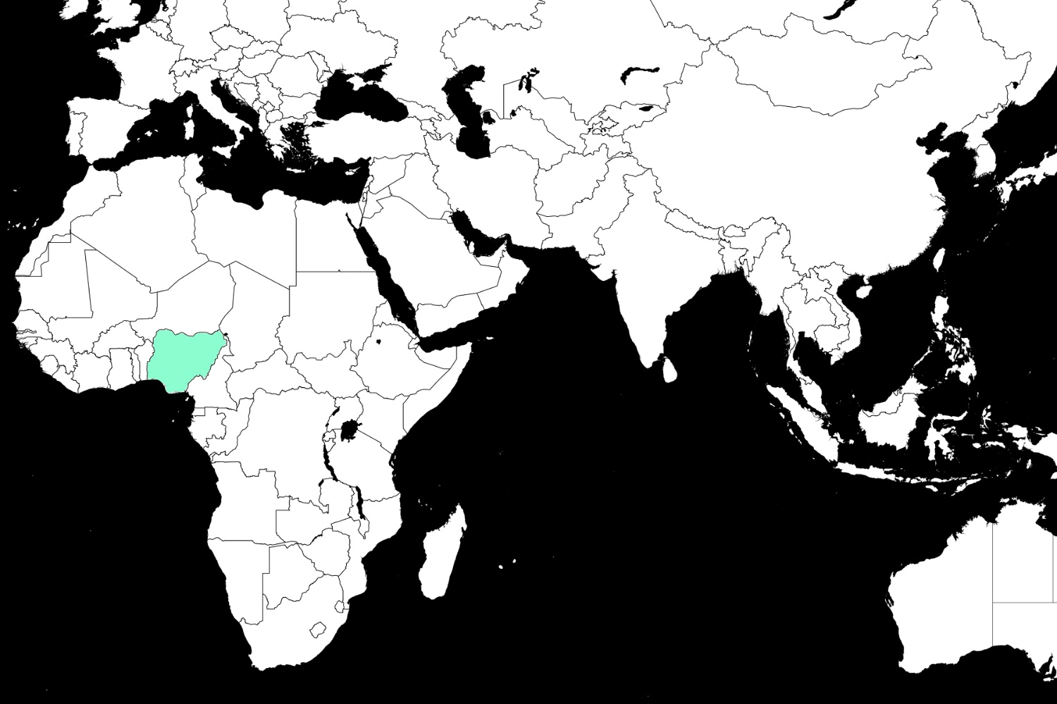
2014 Global Ebola Scare

Slide 4
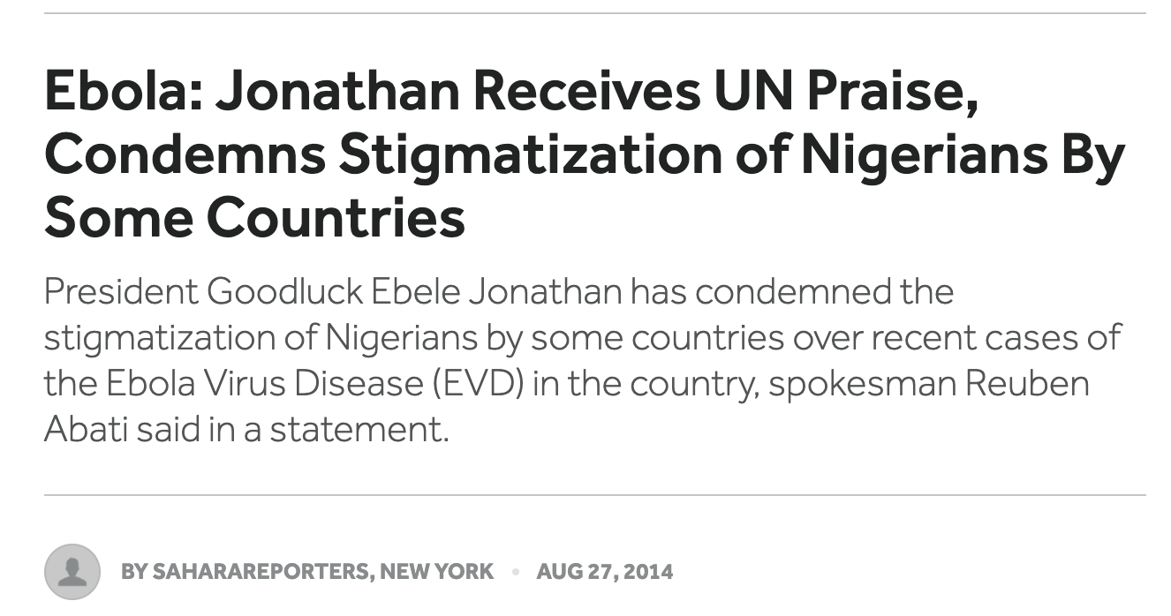
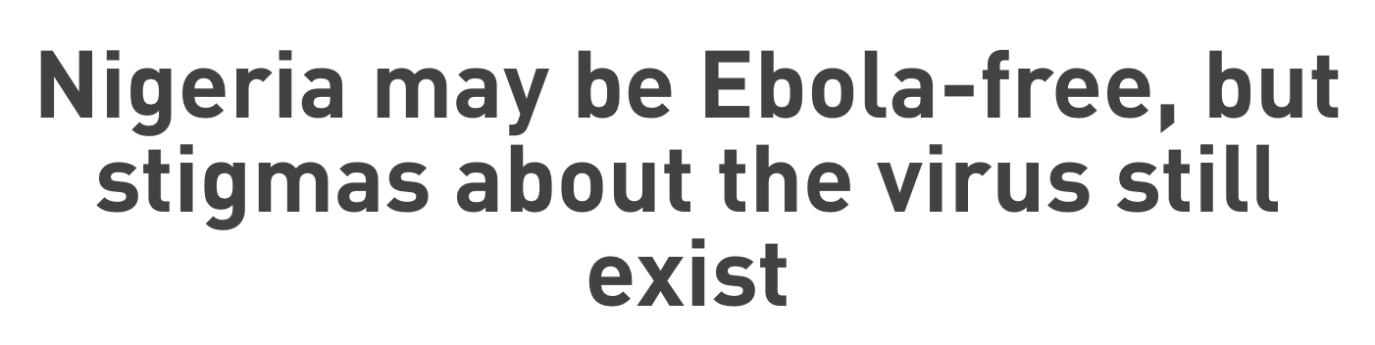
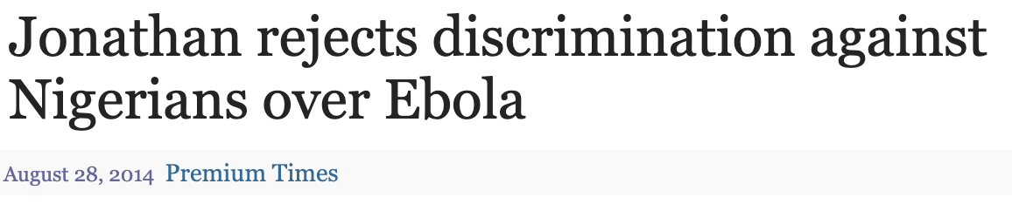
2015 Headlines

Slide 5
anthropology of the ‘event’
Nancy Munn (1990)
formative moments that are infused with the “ambience of potentialities or ‘futurity’, as well as pasts,” events are key sites of translocal consciousness
social worlds and translocal consciousness emerge through everyday practices that infuse “the experience of a given event with pasts (or possible pasts) and futures.”

Slide 7
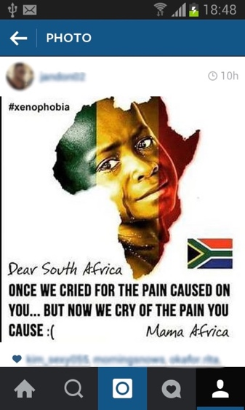
Instagram post circulating on Nigerian social media, 2013

Slide 8
racecraft
Fields & Fields (2018)
“race transforms one person’s action into another person’s being”
“even though the targets may imagine their race is their identity, but in fact it’s an identification.”

Slide 10
Race and notoriety
in diasporic Nigerian life
Vivian Chenxue Lu
Fordham University
vlu2@Fordham.edu

